Slide 1


ENTERO
-ALL IN ONE-

Slide 2
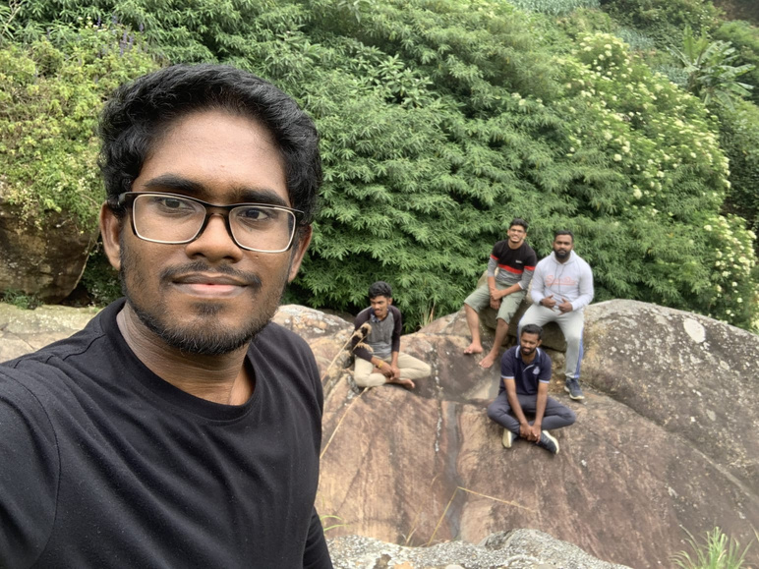
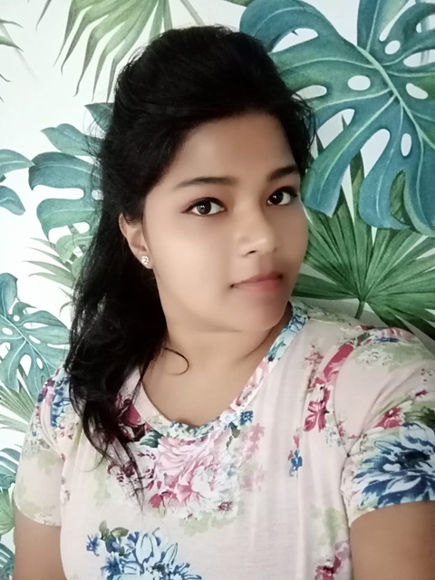
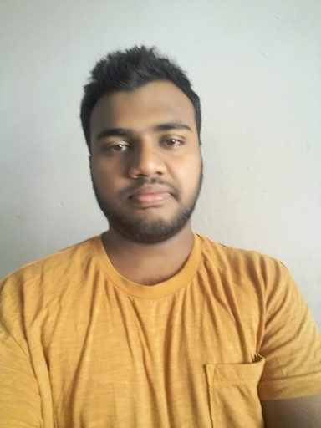


Our Team
Group - G32
Supervised by Ms. Mathangi Krishnathasan
Co-Supervised by Ms. Yasmi Himaya
Sukumar Kavishan
Priskila Athauda
Shakir Saheel
Yonali Fernando
Senal Punsara
G32
Pg 01

Slide 3

INTRODUCTION
Brief Introduction
Problem Identification Solution
Main Functionalities
Quality Attributes
PROGRESS
Presentation
Content
Feedback in Project Defense
Action Plan Execution
Amendments
DEMOSTRATION
User Interface Designs
Completed Implementations
Work in Progress with Timeline
G32
Pg 02

Slide 4

Introduction
G32
Pg 03

Slide 5



No proper event service system
Requirements are not clear
Problem Definition
Customers are not ensured
No multi service providing system
G32
Pg 04

Slide 6

Solution
An event management system
Provide a web based platform for event management Facilitate and satisfy the users towards various services Assist the service providers to reach and promote their business
Customer to fulfill their needed services through this single system.
G32
Pg 05

Slide 7




Functionalities
G32
Pg 06

Slide 8



Admin
User Roles
Customer
Service
Provider
G32
Pg 07

Slide 9
Admin
▪ View past and pending events
▪ View and remove (if needed) customers
▪ View and blacklist (if needed) service providers
▪ View feedback and ratings
▪ Able to generate reports
▪ Update business policies
▪ Update terms & conditions
▪ Manage service charges
▪ View and answer the questions asked in contact us page
G32
Pg 08

Slide 10
Service Provider
▪ Register to the system
▪ Manage account
▪ Create and manage organizational portfolio
▪ Manage and schedule appointments
▪ View and confirm bookings
▪ Chat with the customers
▪ Update the service status
▪ View privacy and policy
▪ View terms & conditions
▪ View ratings and feedback
▪ Pay service charges
▪ Use contact us page for questioning
G32
Pg 09

Slide 11
Customer
▪ Register
▪ Manage customer account details
▪ Customers can search events
▪ Search for services
▪ Make bookings for services
▪ Make appointments with the service providers
▪ Chat with the service providers
▪ View privacy and policy
▪ View terms & conditions
▪ Update the status of the event service
▪ Provide ratings and feedbacks
▪ Use contact us page for questioning
G32
Pg 10

Slide 12






Performance
User
friendliness
Quality Attributes
Usability
Security
Testability
Modifiability
G32
Pg 11

Slide 13

Feedback & Amendments
G32
Pg 12

Slide 14
Feedbacks
Identify the difference between encryption and hashing and implement the proper security mechanism for password storage
Time estimation should be changed in the schedule feasibility section
Identify a way to maintain the deployment and system maintenance cost
Consider the security in using PayHere as the Payment gateway
Consideration about license collision that can happen when using on open source technologies
G32
Pg 13

Slide 15

Amendments
G32
Pg 14

Slide 16
Progress
Front-End
Backend
Database
0%
25%
50%
75%
100%
G32
Pg 15

Slide 17
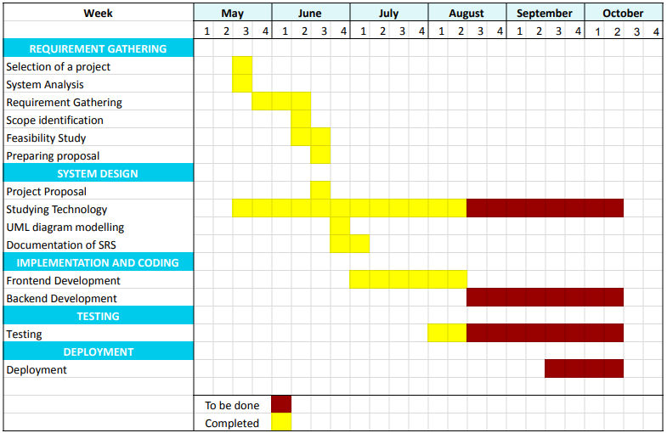
Project Timeline
G32
Pg 16

Slide 18

Demonstration
G32
Pg 17

Slide 19
THANK YOU

